Slide 1
Containers 101
ThriveWise Micro Conference Q1 2022
Imane Qadiri, AWS Neetha Ravishankar, AWS

Slide 2

Agenda
Demystifying containers
Understanding the benefits of containerization
Looking into the applications of containers
Learning about components of containers, concepts & terminologies
Diving deep into containers setup
Exploring the role of containers in cloud computing
Debugging tips & tricks
** Various Hands-on exercises throughout the workshop
This content is for the TW Micro conference Q1 2022

Slide 3
Demystifying containers
Notes:
Drawing from the analogy of shipping containers: standardization of a “box” to ship goods revolutionized shipping. It enabled shipping companies to not worry about what’s inside the box. With the uniform size, they can be transported by trucks, ships, or airplanes. They can be stacked and easily moved.

Slide 4





Containers in software
Bundling up everything a service needs to run - code, runtime, system tools, system libraries and settings into a portable, standalone, executable package.
Provide a standard way to package applications
Run as resource-isolated processes
Ensure quick, reliable, and consistent deployments,
regardless of environment
Notes:
Containers provide a standard way to package your application's code, configurations, and dependencies into a single object. Containers share an operating system installed on the server and run as resource-isolated processes, ensuring quick, reliable, and consistent deployments, regardless of environment.

Slide 5
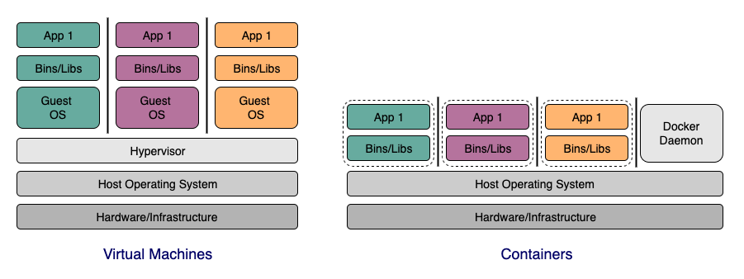
Containers vs. Virtual machines
Notes:
Container is not a VM! It is just another process on the machine with a level of isolation (its view of the world has been altered). Containers - includes applications and everything it needs to run except the O.S. Require fewer system resources, and less overhead. Faster start/Stop and portable across environments. VMs - application and everything needed including O.S. Virtual machines (VMs) virtualize (or remove the need to directly manage) server hardware while containers virtualize the operating system of a server. Docker is an operating system (or runtime) for containers. The Docker Daemon is installed on each server you want to run containers on and provides a simple set of commands you can use to build, start, or stop containers.
3 guest OSes for 3 apps - manage 3 kernels, 3 memory managers etc. Lot of overhead to run 3 apps. - Docker daemon or container runtime is just another process on the machine - Once container starts, just starts a process, sets namespaces etc and out of the way. No sys call translation etc. - All containers are sharing the same kernel. - VMs provide complete abstraction of the system and runs in a environment similar to a bare metal machine. Usecases that need this would not be a good fit to run on containers.

Slide 6

DEMO – file system isolation

Slide 7
“Containers” don’t exist. They are logical objects. Container runtime takes advantage of Linux kernel features to create and delivery functionalities of these logical object

Slide 8
Building blocks - namespaces
Limits what a process can see like other processes, file system
Types – PID, NET, MNT, IPC, UTS
Separate set of namespaces per container
Notes:
Namespaces - allows OS to limit what a process can see like other processes, file system etc. Namespaces are a feature of the Linux kernel that partitions kernel resources such that one set of processes sees one set of resources while another set of processes sees a different set of resources. There are several types of namespaces that Docker utilizes.
PID ns for process isolation. A process ID (PID) namespace assigns a set of PIDs to processes that are independent from the set of PIDs in other namespaces. The first process created in a new namespace has PID 1 and child processes are assigned subsequent PIDs. If a child process is created with its own PID namespace, it has PID 1 in that namespace as well as its PID in the parent process’ namespace.
NET ns for managing n/w interfaces. A network namespace has an independent network stack: its own private routing table, set of IP addresses, socket listing, connection tracking table, firewall, and other network‑related resources.
MNT ns for managing filesystem mount points. A mount namespace has an independent list of mount points seen by the processes in the namespace. This means that you can mount and unmount filesystems in a mount namespace without affecting the host filesystem.
IPC namespace for managing access to IPC resources. An interprocess communication (IPC) namespace has its own IPC resources, for example POSIX message queues.
UTS ns for isolating kernel and version identifiers. A UNIX Time‑Sharing (UTS) namespace allows a single system to appear to have different host and domain names to different processes
Process Isolation, File System Isolation, N/w isolation and many more key components of namespaces is used by Docker. Docker creates a set of namespaces for a container. Each aspect of a container runs in a separate namespace and its access is limited to that namespace.

Slide 9
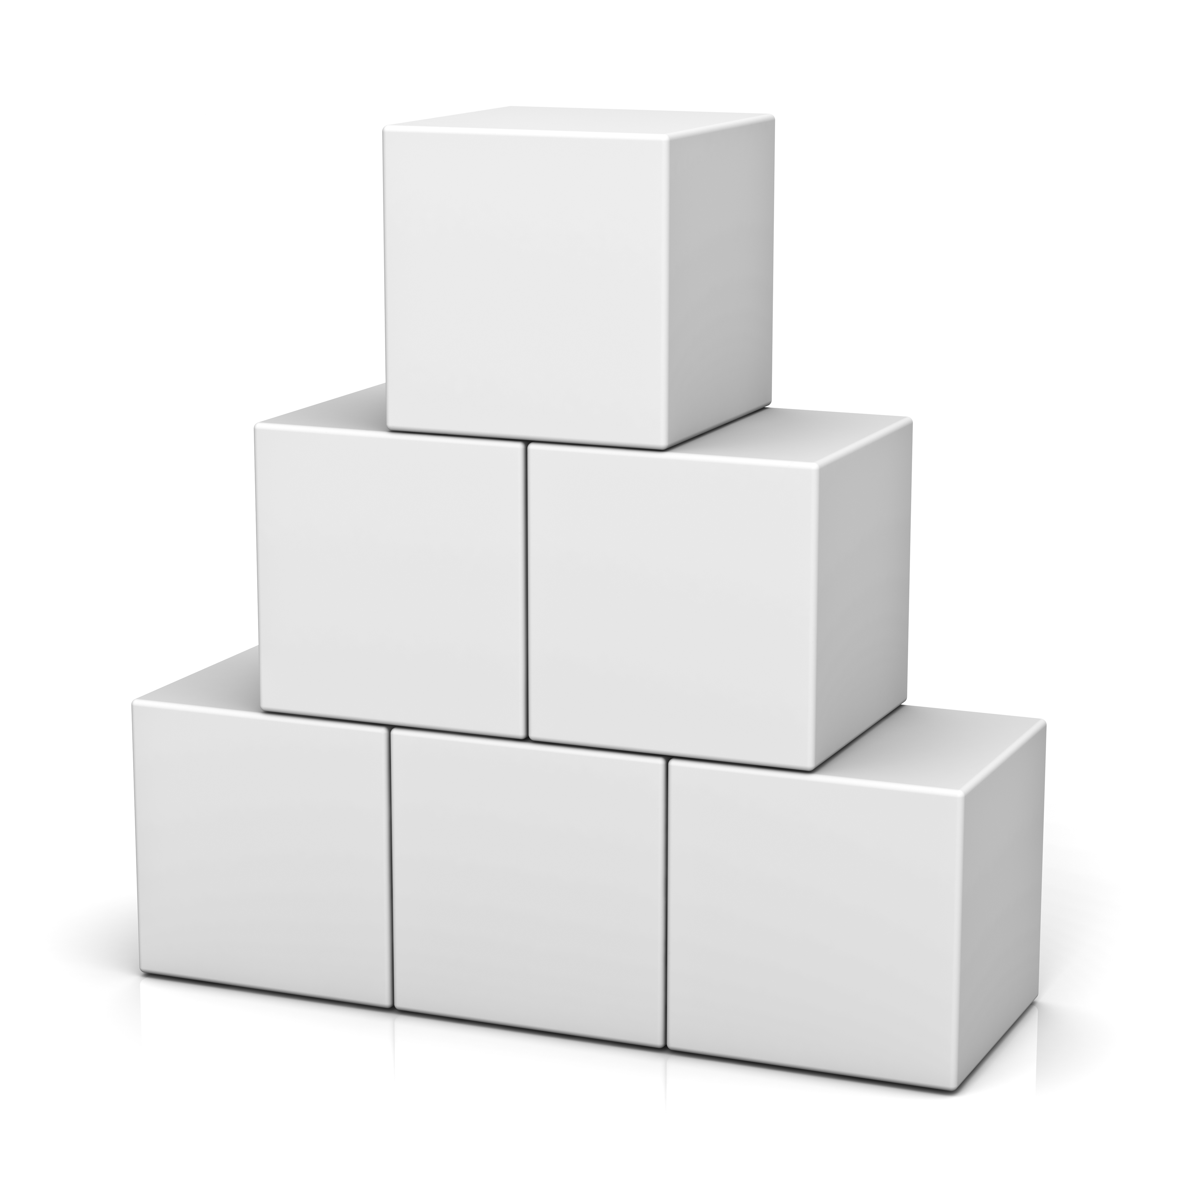
Building blocks - cgroups
Limits resources a process can use
Useful for resource allocation and isolation
Allows container runtime to share available hardware resources among containers
Notes:
CGroups - limits what resources a process can use, how much cpu, memory etc. Mediated by Cgroups. Docker uses cgroups for resource allocation and isolation. This allows Docker engine to share available h/w resources among its containers and enforce limits and constraints if necessary.

Slide 10

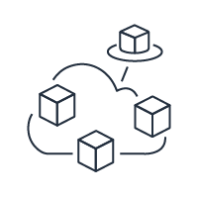


Benefits of containers
Portable & Consistent
Lightweight & Scalable
Accelerate Development
Notes:
Portable & Consistent: Since the container includes all of the dependencies and configurations, you can write once and move between environments (local, cloud, on-prem) Lightweight: isolated from the OS layer, efficient and light on resources compared to virtual machines.
Scalable: small size, containers rapidly spin up, scale on the fly, spin down when not in use and quickly restart when necessary
Accelerate Development: Containers provide a stable, predictable environment, where CPU/memory is optimized and code is abstracted from infrastructure for portability. Using containers, developers can break applications into microservices, which can speed up development and, when deployed, be scaled individually

Slide 11

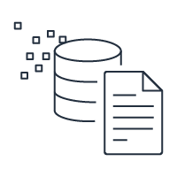
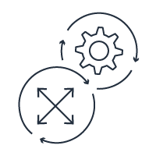
Container use cases
New Applications
Distributed Applications
Build-once-deploy-anywhere Applications
Notes:
- Applications that are hard to develop quickly because of interdependencies and requiring integration of multiple technologies like web server, content manager, content and code, storage, middleware etc a.k.a microservices based architecture. Containers create the opportunity to decouple the deployment of components, thereby allowing changes and upgrades to each component to happen independently. This allows each development pipeline to proceed without interference
- Ability to reuse and centralize configurations is a good fit for applications that share a common configuration pattern. A common pattern or configuration can be established as a base image, and then extended by the development teams.
- If new applications are built from scratch
- Looking for potable, build-once-deploy-anywhere solution

Slide 12
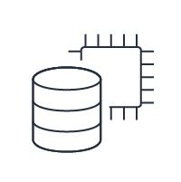

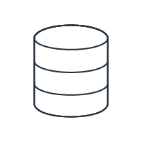
When not to use containers
Monolith Application
Compute Heavy Applications
GUI Rich Applications
Notes:
- Existing monolithic applications - might require development time and money to break up how it works
- Similar to how some physical machines don’t translate to VMs, applications that demand lot of resources - not good candidates for containerization
- CPU RAM hungry application require effort to break up into containers - but might have little to no benefit.
- Applications requiring speed boost. Docker will use as much system resources as the host’s kernel scheduler will allow. An additional layer between an application and the operating system could also result in speed reduction. Docker containers are not fully isolated and do not contain a complete operating system like any virtual machine.
- Applications that require rich UI. Docker is mainly intended for isolated containers with console-based applications. GUI-based applications are not a priority, their support will rely on the specific case and application.
Examples: Gaming applications, training complex ML models, etc.
Some other cases where containers are not fit: Graphical applications don’t work well. By design docker is a solution for deploying server applications that don’t require a graphical interface. Although there are workarounds to use GUI app, it is not the best experience.
Applications that need to persist large amounts of data will have an overhead of persisting data elsewhere by transferring data over the network since data inside the container only persists until container shuts down.
Network intensive applications like those that need to stream large amount of data over the network like video streaming applications don’t perform well on containers because of performance overhead due to overlay networking in comparison to running it on bare-metal.

Slide 13
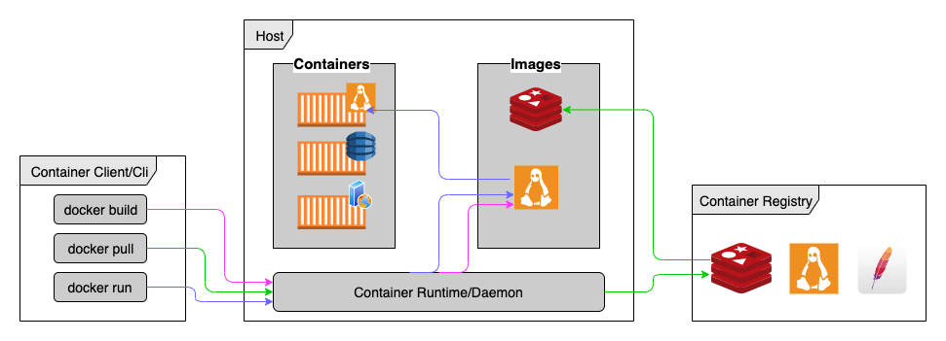
Introducing docker
Notes:
Container as an idea has existed long time but Docker made it easy to use the things in containers on the cli. Docker - Container Service or container Runtime. Its the industry standard for what defines a “container”. Docker has two parts - a client and a server. Client is what users interact with via CLI. CLI uses Docker APIs to interact with the long running process dockerd. It talks to the daemon, running either on the same system or connect to a remote daemon, to do the heavy lifting of building, running and distributing Docker containers. Docker registry is a hub to store and share images. Docker Hub is a public registry that has thousands of images and by default Docker is configured to connect to it. There are other available registries like AWS ECR where images can be pushed to and pulled from.

Slide 14
Docker image
Template with instructions to create and run containers
Image layering
Dockerfile - script to build an image
Notes:
Template with instructions on how to create and run a Docker container
Typically created by starting off with a base image like ubuntu or alpine, and install your application along with required dependencies and configuration to run your application.
Container is a runnable instance of an image.
Dockerfile - a script to build an image
Simply a text file - can be version controlled, shared easily
Each instruction created a separate layer in the image.
During build, only the layers which have changed in the Dockerfile is rebuilt.
Build an image using docker build command
Sharing images
Uses registry. Default to docker registry called Docker Hub
Many other registries. AWS ECR.
docker push command is used to push an image to a registry
Once pushed, others can pull the image from it and run it on a container.
Image layering:
Every command in Dockerfile will produce a new layer with each layer’s filesystem stored as a single tar file
Layers are generated/merged by union - Higher layer files replace the same files in lower layers. “whiteout” [.wh.file4] file for deletion of file4. Becomes not visible in merged fs but still shipped as part of previous layer.
Images are composed of layers of file system changes with each layer containing an additional or removal from previous layer.
“docker image history“ command shows all layers and command used to generate each layer.

Slide 15
Docker container
Container is a runnable instance of an image
Well isolated from host and other containers – its own network, storage and other subsystems
Defined by image + configurations provided during “docker run”
Notes:
A container is a runnable instance of an image. You can create, start, stop, move, or delete a container using the Docker API or CLI.
You can connect a container to one or more networks, attach storage to it, or even create a new image based on its current state.
By default, a container is relatively well isolated from other containers and its host machine. You can control how isolated a container’s network, storage, or other underlying subsystems are from other containers or from the host machine.
A container is defined by its image as well as any configuration options you provide to it when you create or start it.
Docker run command –
Pulls the base image if not present, Created a new container
Allocated required read/write FS, network interfaces, IP address.
Starts the container – if chosen executes bash
“exit” command inside bash stops the container but not removed.

Slide 16
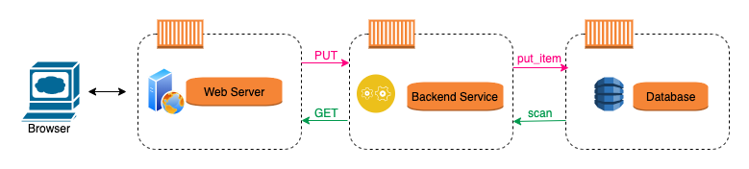
What are we building today?
Notes:
In today’s workshop we will be working in stages to build a simple application that leverages micro-services architecture.
A TO-DO list web application
- To store and retrieve a list of items
- Completely containerized
- 1 container will host the web server (nginx)
- 1 container for DB (DynamoDB Local)
- 1 container for backend service with all the business logic (Build using Python and run on Alpine base container)
As we learn about the different basic concept of containers, we will try and apply them across various exercises to build this application.

Slide 17
Exercise 1
Create Dockerfile
Build the image
Run a container
Notes:
Building the first image, and running the first container

Slide 18
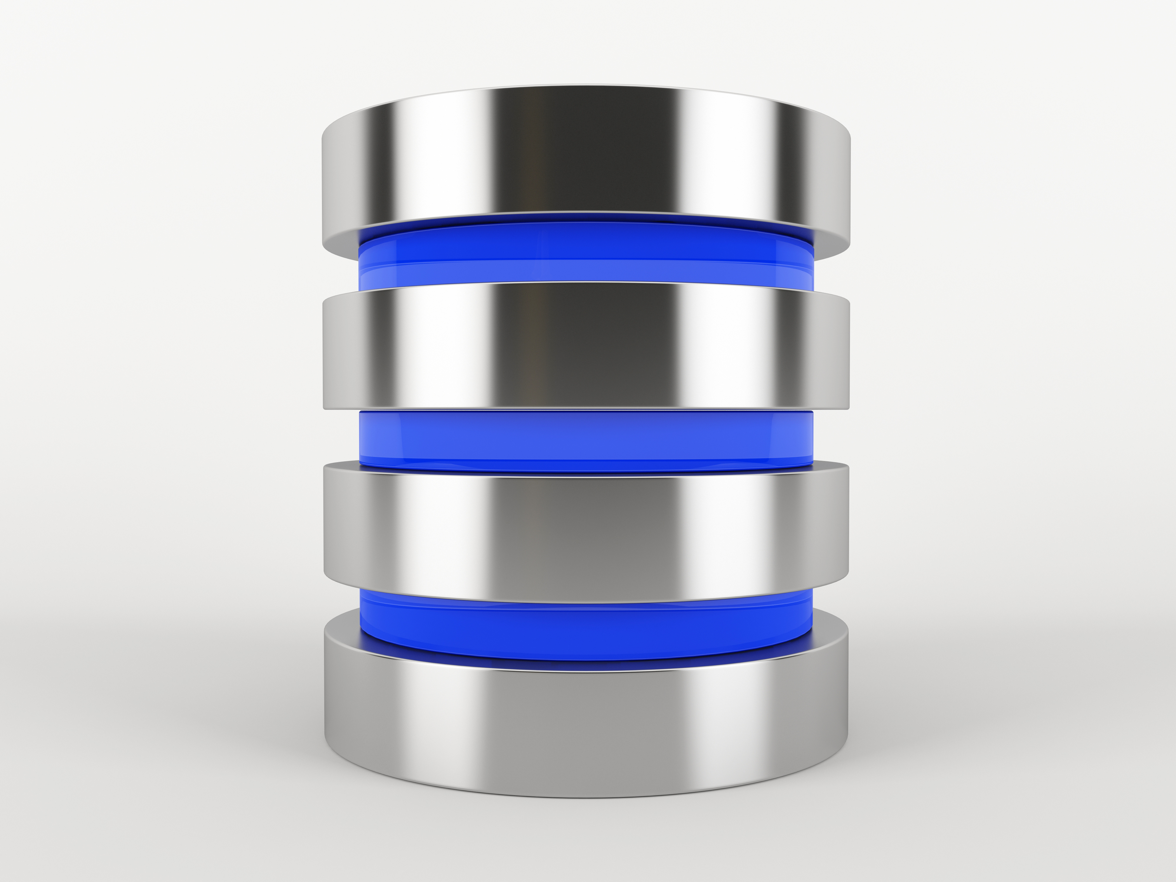
DEMO – Data persistence

Slide 19

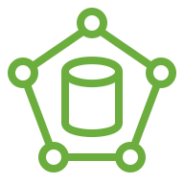
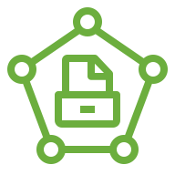


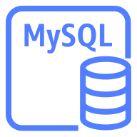
Docker Storage
Data in containers not persisted by default
Types of volumes for achieving persistence
Bind mounts
Named volumes
Notes:
By default, data is not persistent after a container exits.
Two options to persist or supply data to containers. Allows data to be persisted longer than the container.
Root fs is coming from image, but can augment other sources of data from host or n/w store etc.
2 types of volumes:
Bind mounts - bind specific directories to specific spot in fs. Example: “-v $HOME/mysql-data:/var/lib/mysql”
Changes in one are changed in the other
Stored anywhere on host
Non-docker processes on host as well as Docker containers can modify them
Named volumes (preferred method) - let docker choose where to persist data. Create volume names or buckets and use that name to refer to it.
Stored in a part of host filesystem that is managed by Docker
/var/lib/docker/volumes/ on linux
Non docker processes should not modify this part of the filesystem
“docker volume create”
“docker volume inspect” to find actual location. Example: “-v mysql-data:/var/lib/mysql”

Slide 20
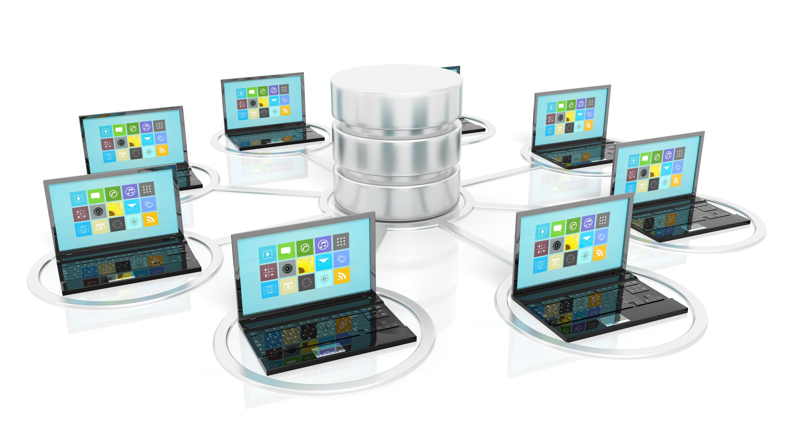
Docker networking
Communication boundaries between containers
Containers on same network can talk to each other using alias or IP address
Docker runtime becomes the DNS resolver
Default docker networks: None, Host and Bridge
User defined networks: Bridge, Overlay, Macvlan
Notes:
Networking i.e, communication boundaries/isolation: Two containers on same network can talk to each other
Docker becomes the DNS resolver on each network
Two containers connect to each other using alias. Resolves IP addresses of other containers using alias.
Making it easy - containers come & go, docker keeps track of it.
Default Docker networks
Docker platform automatically configures three different n/ws during installation - none, host and bridge. None and host are part of n/w stack in Docker and they have no external interfaces to configure. Bridge n/w also known as the docker0 n/w can be configured. This n/w automatically creates an IP subnet and gateway and all containers that belong to this network are part of the same subnet. So communication between them can occur in this network via IP addressing.
In order for containers in default n/w to talk to each other, they must use the -- link option to statically allow communications and require port forwarding between them since automatic service discovery using DNS is not supported.
User defined networks:
Bridge n/w: Like the default bridge network, a user-defined bridge network is a self-contained IP subnet and gateway. But unlike the default bridge, all containers within the user-defined bridge can communicate directly to one another without the need for port forwarding. Additionally, automatic discovery using DNS is fully supported on this network. If you want other devices in other networks to communicate with resources in your user-defined bridge network, you simply publish the TCP/UDP ports you need and Docker will expose the network addresses and ports to outside networks.
Overlay network - distributed n/w with containers spanning across hosts. Needs containers to enable swarm mode. Swarm mode is Docker’s method of allowing for the management of a cluster of Docker engines, known as a “swarm.”
Macvlan network - This user-defined network type attempts to simplify and streamline container communication by eliminating the bridge that resides between the container and host when using bridge and overlay networks. The main benefit here is that it automatically exposes external-facing container resources to outside networks without having to deal with port forwarding. A Macvlan network accomplishes this by using layer 2 MAC addresses as opposed to layer 3 IP addressing.
Creating new network: “docker network create <name>” or “docker network create —driver bridge <name>”
“docker network inspect <name>” : to view IP subnet, gateway and each container connected.
“docker run -it — network <net-name> <image>“ to add to a network. Alternatively ”docker container attach <container-name>“

Slide 21
Exercise 2 & 3
Complete the 3 pieces of the micro-service
Run 3 containers
View the results
Notes:
Finishing 3 pieces of the microservice – running 3 containers and viewing the results.

Slide 22





Container orchestration
Orchestrating workloads on fleets
Managers & Workers/Agents
Docker swarm, Amazon ECS and many more…
Docker compose tool
Defining and running multiple containers
Notes:
Manage running container workloads, on fleet of machines
Define “expected state” and system tries to make “actual state” reflect “expected state”.
2 types of actors:
Managers: brain of the cluster. Maintain state, schedule work
Workers/Nodes/Agents: perform actual work as instructed.
Docker swarm - shipped with Docker engine
Amazon ECS - integration with AWS resources
Compose is a tool for defining and running multi-container Docker applications. With Compose, you use a YAML file to configure your application’s services. Then, with a single command, you create and start all the services from your configuration.
Using Compose is basically a three-step process:
Define your app’s environment with a Dockerfile so it can be reproduced anywhere.
Define the services that make up your app in docker-compose.yml so they can be run together in an isolated environment.
Run docker compose up and the Docker compose command starts and runs your entire app. You can alternatively run docker-compose up using the docker-compose binary.

Slide 23
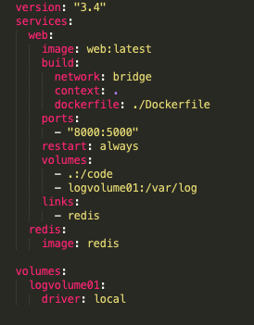
Docker compose

Slide 24
Exercise 4 & 5
Create Docker compose
Pass an Environment Variable to the container
Notes:
Finishing 3 pieces of the microservice – running 3 containers and viewing the results.

Slide 25
Containers & cloud computing
Align on micro service architecture
Debug easily and diagnose errors faster
Maximize scalability and flexibility
Notes:
Containers are a natural fit for many organizations with development teams deploying applications into the cloud.
The component of the program is segregated into different entities that run a separate micro-service - which can scale independently. This fits well with the way most applications are architected for cloud.
Cloud containers and microservices create a consistent and predictable environment, along with familiar tools and resources. Consequently, tasks such as debugging code and diagnosing errors are greatly reduced, regardless of where the application resides. Developers can spend more time on productive tasks, including adding and improving features in software.
Maximizing scalability and flexibility are the key reasons to use containers which is also a primary reason for many people to migrate to the cloud. Virtualization and continuous delivery seem to be perfectly suited to the cloud (or to a cloud-like environment)

Slide 26
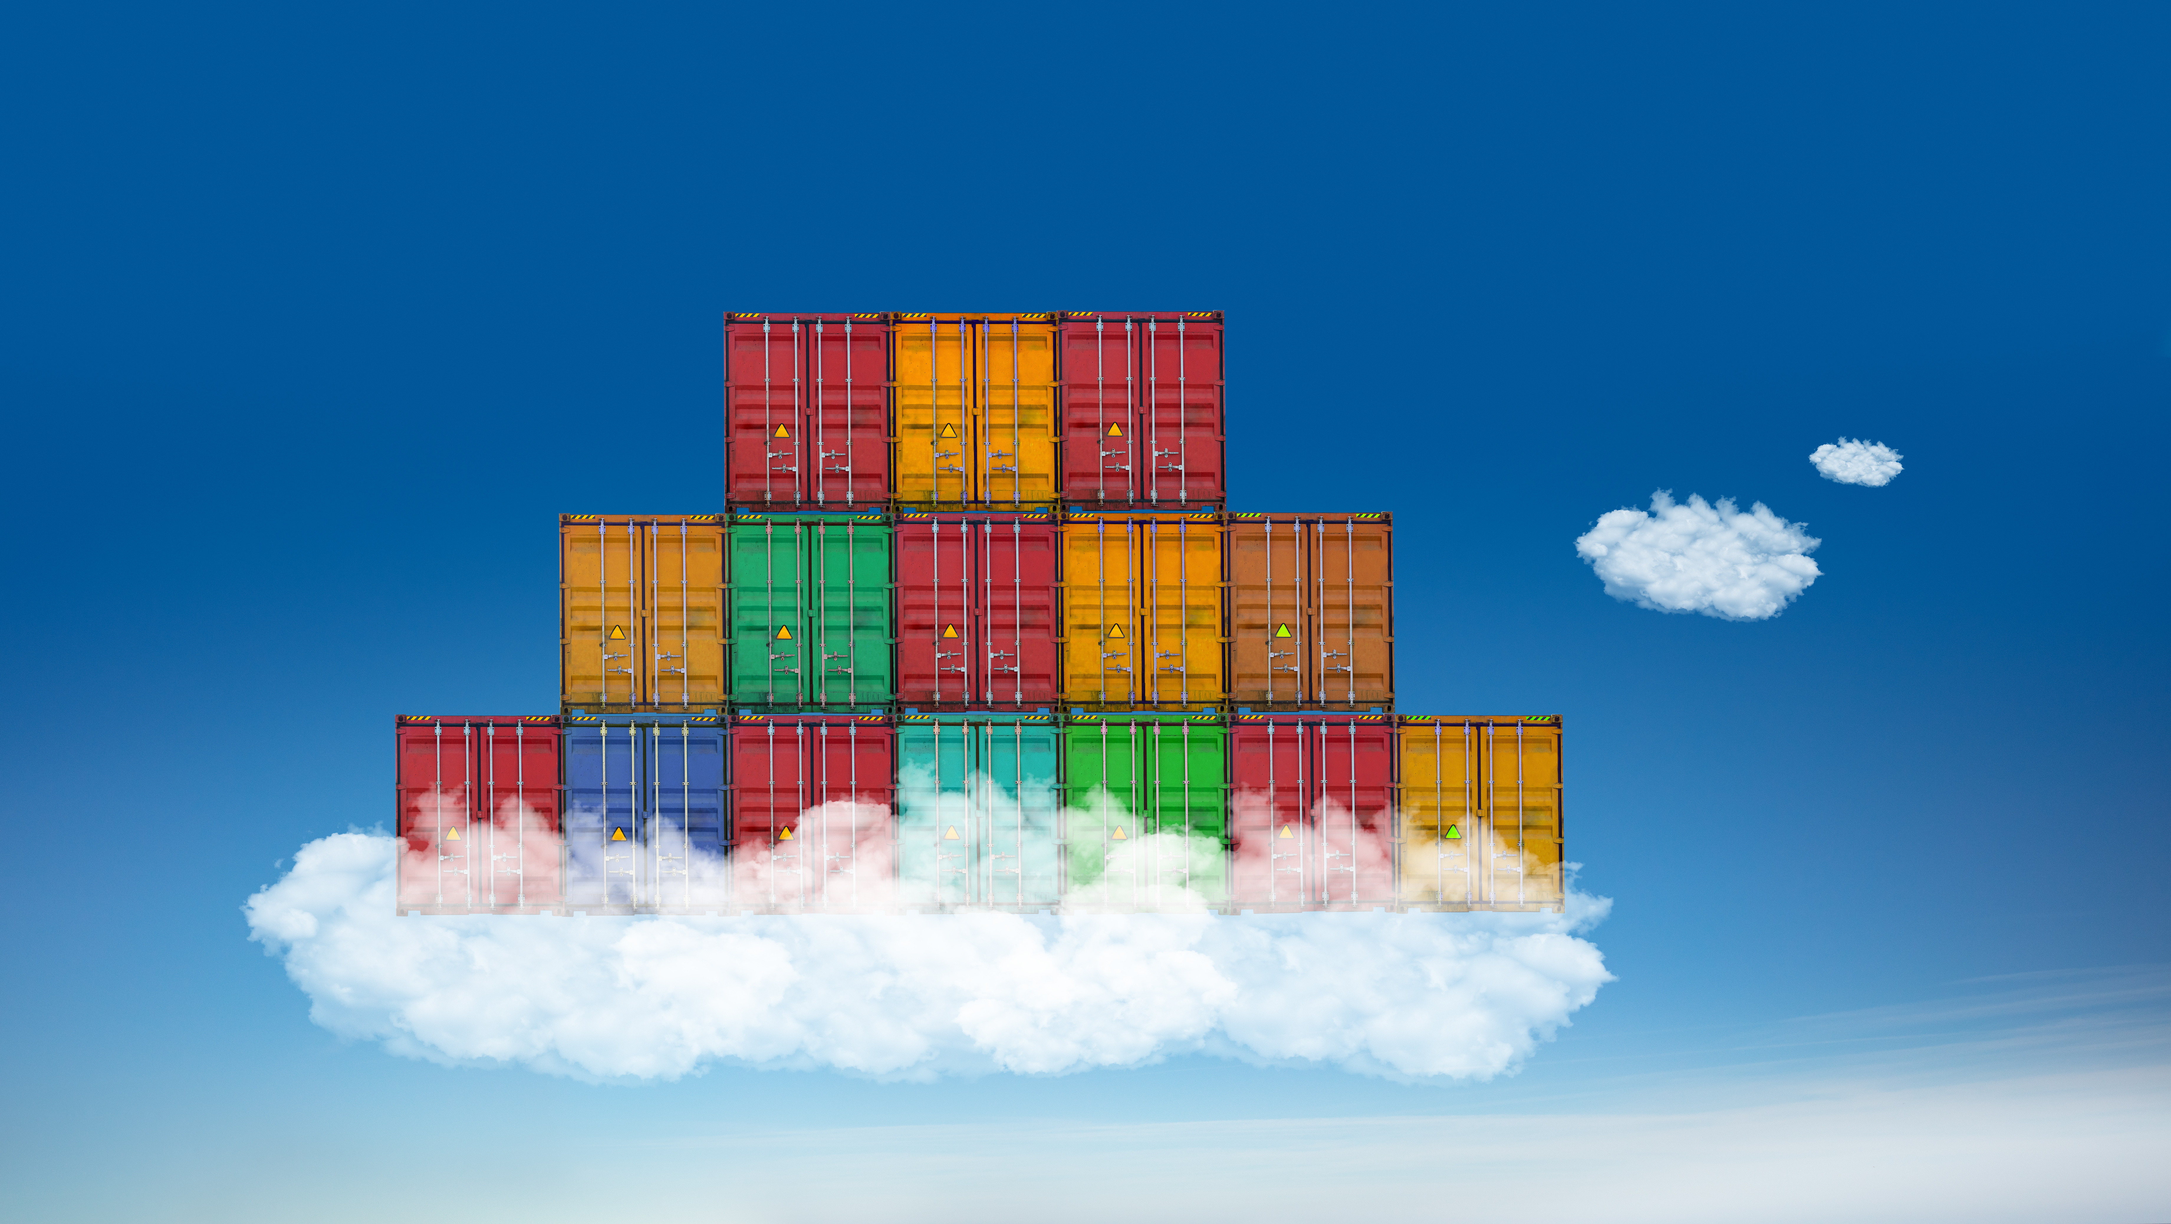
Cloud DEMO
Notes:
Running application built locally on cloud.

Slide 27
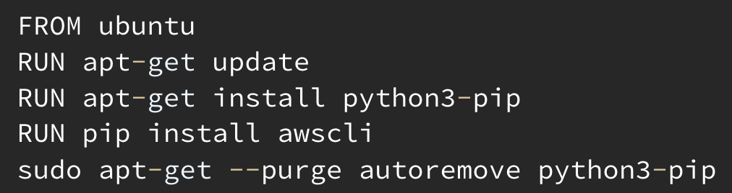
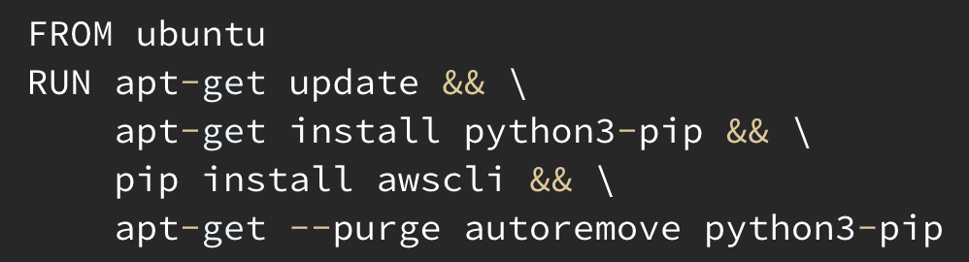
tips & tricks
Chaining RUN commands
v/s
Tight and focused images
Deleted files are recoverable due to Image layering
Bind mounts can have side effects and security implications
Notes:
Chaining RUN commands. Clean up along the way: Each command is a layer. Removing unwanted files after use. Think about what is being put into each layer and think about if this is needed or not.
Same image in the end but reduces image size by a lot!
Images need to be tight and focused. Not a general purpose container that can do everything, that is not the point of a container. Installing only what is necessary - filesystem specifically tailored to run a specific app.
Multi-stage builds to separate build-time and run-time dependencies.
Example1: [Image] building react app needs node (use node container). End result is just standard html, js, css. Don’t need node to serve the content. Use nginx container to run/serve the app.
Example2: First image with jdk/maven/gradle and don’t need jdk in production. Use second image with jre/tomcat/wildfire. So pull war file and put into final image.
Each container doing one thing makes it easy to scale.
Example: Having APIs and databases in different containers helps scale them independently according to need.
Keeps them lightweight and updating different bits of the service becomes easier
Careful what is put into images as deleted files are not actually done. Image layering. Able to view what is in each layer.
Do not bake any secrets into files, even if removed not actually gone!
Image can be saved into tar file and each layer can b retrieved. Including the file.
docker image save command: “docker image save <image> | tar xf -” : Creates a tar file with all layers bundled into it.
manifest.json tells all the layers. go to layer where a file was added. Can see file that was later deleted.
One side effect of using bind mounts, for better or for worse, is that you can change the host filesystem via processes running in a container, including creating, modifying, or deleting important system files or directories. This is a powerful ability which can have security implications, including impacting non-Docker processes on the host system.

Slide 28

Conclusion - Have fun!
Notes:
Conclude by summarizing the key learnings

